Slide 1

Critical Alarm/Network Restarts Prediction Use Case
© wen jhe lee 2017

Slide 2
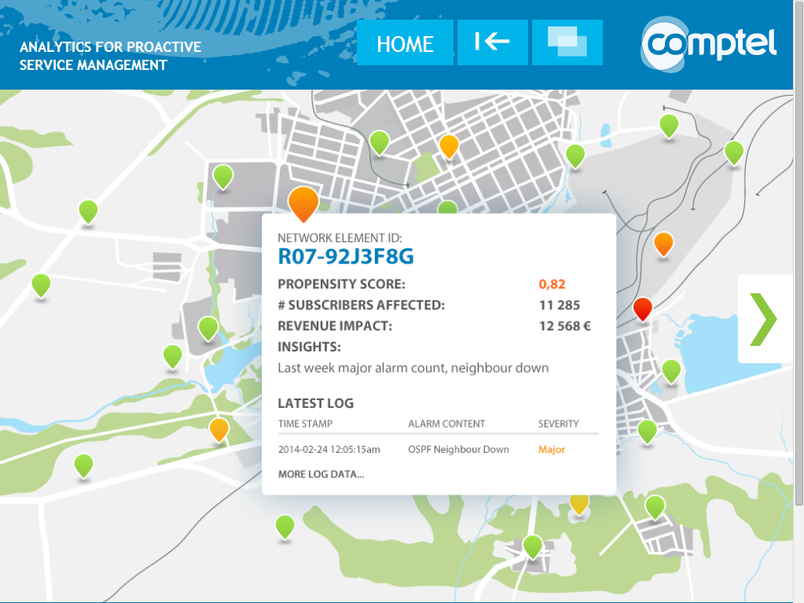

Slide 3
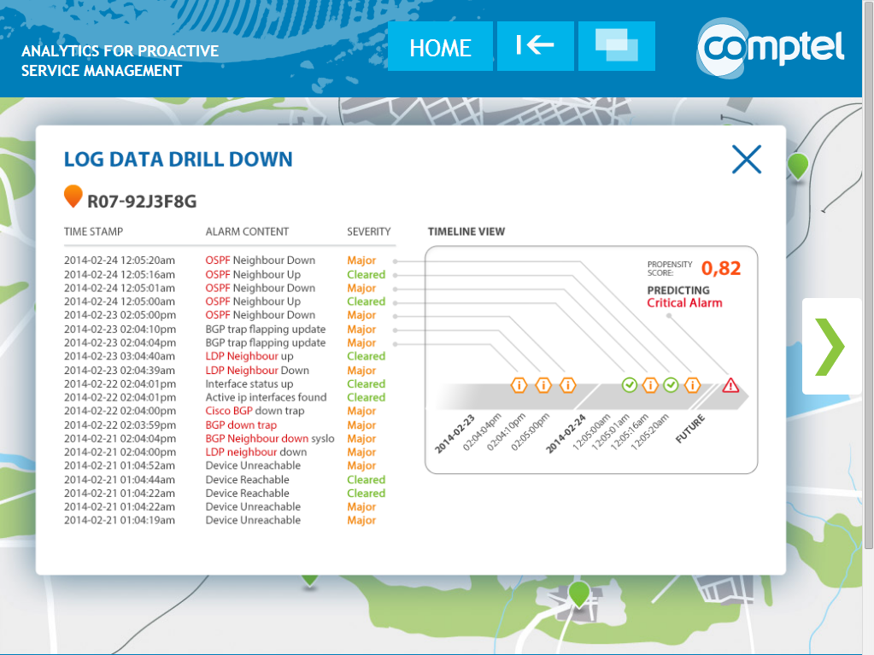

Slide 4
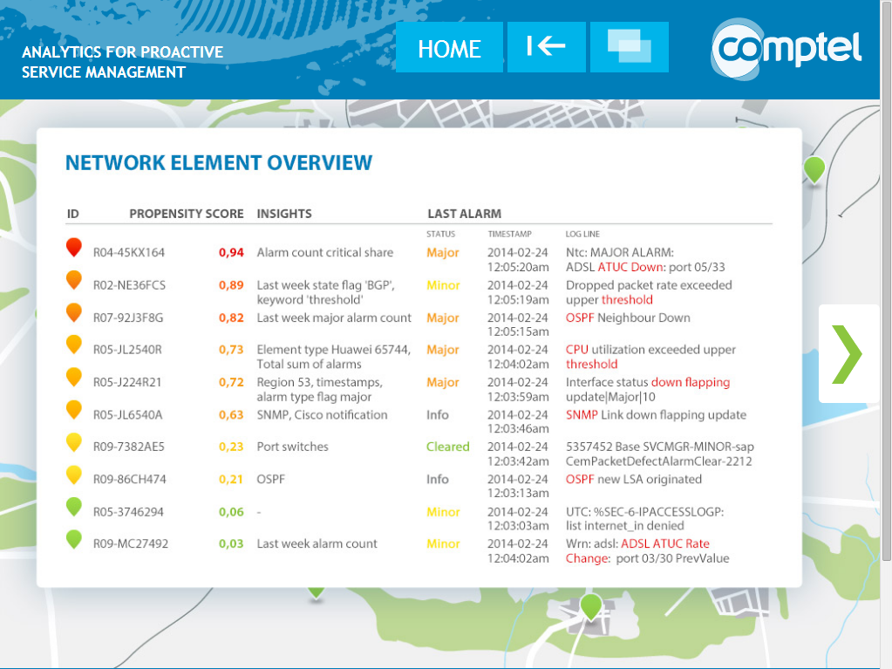
Data
Alarm logs
Event logs
Rated usage data
Network topology
Analysis
Critical alarm / issue prediction
Revenue impact analysis
Root cause insights
Action
Proactive maintenance for issues prevention

Slide 5





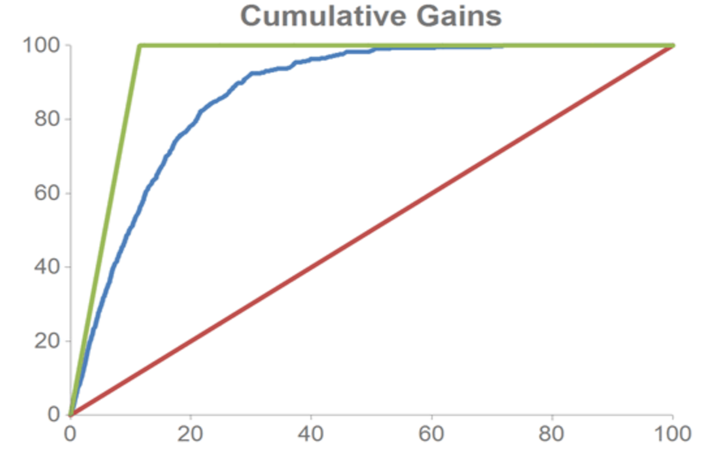

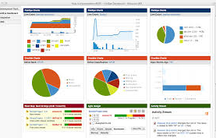


Solution

Slide 6

Extraction and Load

Slide 7

Transform

Slide 8
Historical data is used for training the model Accuracy testing on separate ”apply” data set
Model training (fitting)
Model testing (applying)
Historical event and alarm data from days 1-7
RNC board restart from day 8
Historical alarm data from days 8-14
Prediction for day 15
Model accuracy can be validated using an independent data set
Model trained to predict which controllers produce RNC board restart on next day
August 2012
 |  |  |  |  |  | 1
2 | 3 | 4 | 5 | 6 | 7 | 8
9 | 10 | 11 | 12 | 13 | 14 | 15
16 | 17 | 18 | 19 | 20 | 21 | 22
23 | 24 | 25 | 26 | 27 | 28 | 29
30
Jul 2013
 | 1 | 2 | 3 | 4 | 5 | 6
7 | 8 | 9 | 10 | 11 | 12 | 13
14 | 15 | 16 | 17 | 18 | 19 | 20
21 | 22 | 23 | 24 | 25 | 26 | 27
28 | 29 | 30 | 31
June 2014
 |  |  |  | 1 | 2 | 3
4 | 5 | 6 | 7 | 8 | 9 | 10
11 | 12 | 13 | 14 | 15 | 14 | 15
18 | 19 | 20 | 21 | 22 | 23 | 24
25 | 26 | 27 | 28 | 29 | 30 | 31
Training data (327 days)
Testing data (327 days)

Slide 9
Model
Modelling

Slide 10
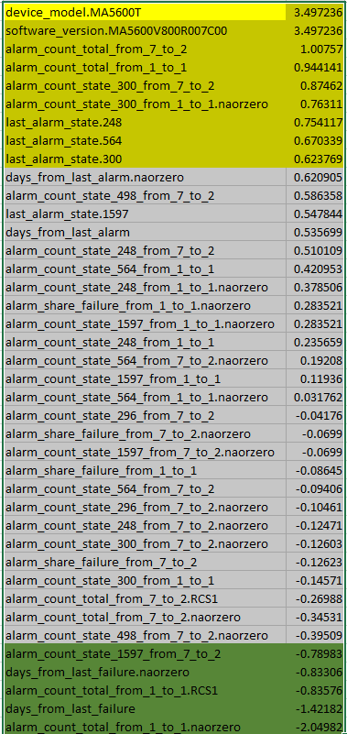
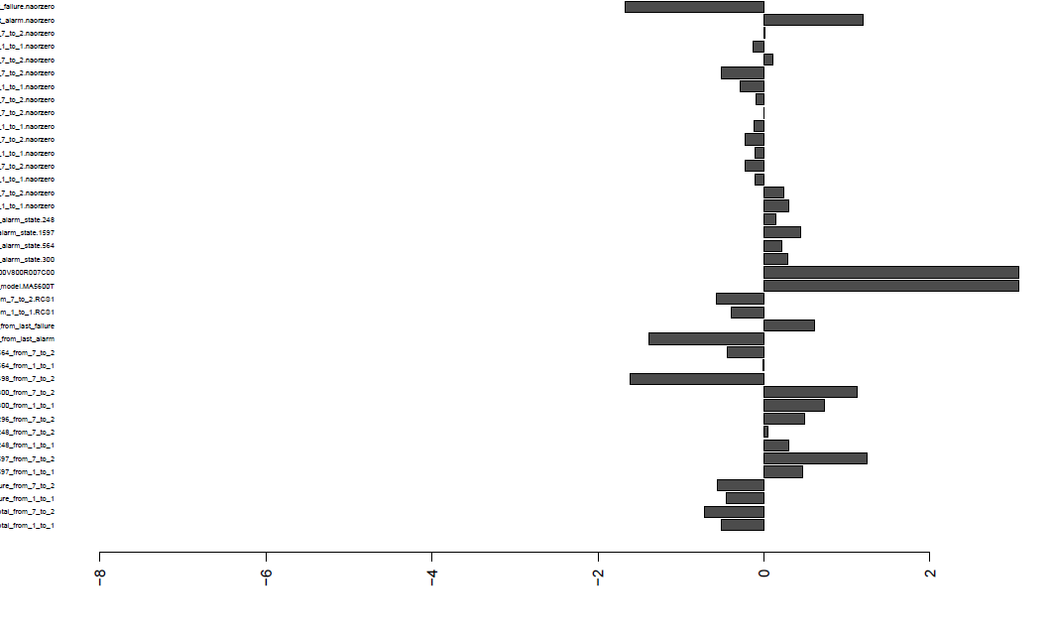
Which predictors used in the model?
Each variable given a weightage factor which root cause can be determined

Slide 11
The Model :Model weights provide root cause insights
Increases RNC board restart probability | Weight
rnc_llog_week_flag_0221 | 1.63
rnc_llog_week_flag_0207 | 1.30
rnc_ev_week_record_RncFunction_NodeRNC board restartCompleted | 1.22
rnc_llog_week_flag_0022 | 1.09
rnc_llog_week_flag_0101 | 0.98
rnc_ev_week_record_A Non-Local MAU Has Been Chosen as the Active Client. The Active Client MAU LDN: | 0.74
b_al_day_flag_Ceased. NAORZERO | 0.70
rnc_llog_week_flag_0008 | 0.66
b_ev_week_record_SlotNew PIU detected matches the defined configuration | 0.65
b_ev_week_record_Licensing_FeatureChange | 0.61
b_ev_week_record_NodeCredentialsinstalled | 0.58
humidity | 0.35
...
Decreases RNC board restart probability | Weight
rnc11 | -2.99
rnc_llog_week_flag_0108 | -1.78
rnc_ev_day_record_A Non-Local MAU Has Been Chosen as the Active Client. The Active Client MAU LDN: | -1.35
b_al_week_flag_Critical | -1.31
rnc_llog_week_flag_0118 | -1.26
b_ev_week_record_Licensing_CapacityChange CXCCLev =HLim = NAORZERO | -1.17
rnc_ev_week_record_Default router switch. IP_INTERFACE_DH_DEFAULTROUTER_SWITCH NAORZERO | -1.16
rnc_llog_week_flag_0206 | -1.12
evo03 | -1.08
rnc15 | -0.99
...
Rnc_llog – can be interpreted as if there are RNC board restarts previous week likelihood of RNC board restart increases
Certain RNC has low chances of RNC board restarts
Absence of Node B License Capacity Change or RNC record of Default Router Switch decreases likelihood of RNC board restarts
Absence of ceased Alarms from Node B would increase probability of future RNC board restarts – Have not fixed alarms?
Note: model weights should be interpreted based on understanding of the managed network, since high weights may also result from correlation with an underlying cause not visible in data

Slide 12
Example: 81% accuracy in port failure prediction Accuracy for 28 Jul (prediction list’s top 10% most likely to fail)
81%
81% of ports in top 10% (of all ports) produce rnc restart failure message on day following prediction

Slide 13
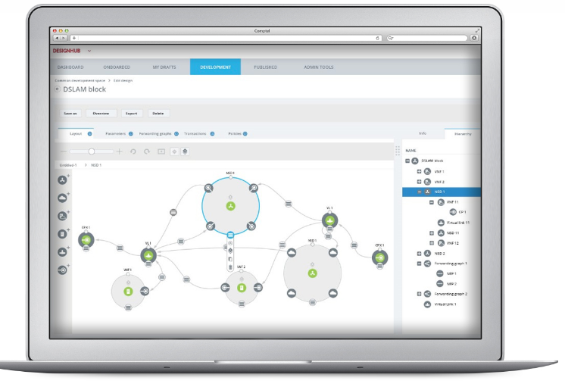
Action

Slide 14
Example output
Post-event evaluation
Output file content
Port ID | Failure prediction score for 28 Jul
10.248.186.16/0/3/3 | 0.999
10.248.152.4/0/7/0 | 0.999
10.248.145.5/0/2/0 | 0.999
10.248.166.5/0/2/1 | 0.999
10.248.235.10/0/1/5 | 0.999
10.248.148.8/0/3/2 | 0.998
10.248.160.7/0/6/1 | 0.998
10.248.174.9/0/4/1 | 0.998
10.248.148.6/0/16/1 | 0.998
10.248.151.6/0/5/1 | 0.998
... | ...
Failure on 28 Jul
Yes
Yes
Yes
Yes
Yes
Yes
Yes
Yes
Yes
Yes
...
Score between 0 and 1; high score indicates high probability of failure message on 28 Jul
Port ID

Slide 15
